Slide 1
Objectives
In this session, you will learn to:
  Map an ER diagram to a table

Slide 2
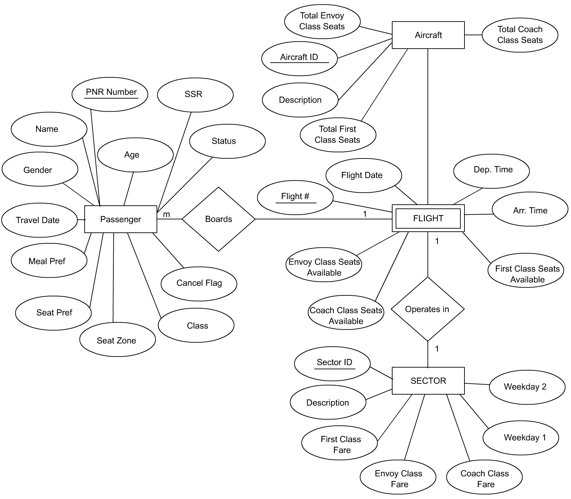
Demo: Mapping the ER Diagram to Tables
Problem Statement:
  Map the following ER diagram to its corresponding tables.
Notes:
Student already have learnt about type 2 SCDs in Module I. Therefore, you can start this topic by asking the following questions to students:
What are type 2 SCDs?
Given an example to explain type 2 SCDs.
This will recapitulate what they have learnt about type 2 SCD in Module 1.
Now explain the strategy to update the data into these dimension tables with help the example given in SG.
After explaining the examples, you can ask students to think of an example of a type 2 SCD and then tell the strategy to update the data into this dimension table.

Slide 3
Practice Exercises
Exercise 1:
  Design an ER diagram for the following situation:
  An organization has two types of employees, salaried and wage earning. Both the types of employees have some common properties that are the employee code, employee name, and employee address. However, the salaried employees have other additional properties that are basic, allowance, and house rent allowance (HRA). The wage-earning employees have distinct properties that are daily wage and overtime.
Notes:
Student already have learnt about type 2 SCDs in Module I. Therefore, you can start this topic by asking the following questions to students:
What are type 2 SCDs?
Given an example to explain type 2 SCDs.
This will recapitulate what they have learnt about type 2 SCD in Module 1.
Now explain the strategy to update the data into these dimension tables with help the example given in SG.
After explaining the examples, you can ask students to think of an example of a type 2 SCD and then tell the strategy to update the data into this dimension table.

Slide 4
Practice Exercises (Contd.)
Exercise 2:
  Shopping Spree is a leading departmental store in Shanghai. The store has a number of regular customers who purchase bulk items. The store also conducts regular feedback sessions to analyze customer satisfaction levels. Chen, the customer analyst of Shopping Spree has to make the E/R diagram to represent the preceding situation and then map the E/R diagram to corresponding tables. Help Chen to do the same.
Notes:
You can summarize the session by running through the summary given in SG.
In addition, you can also ask students summarize what they have learnt in this session.

Slide 5
Summary
In this session, you learned that:
  The entities in an ER diagram can be mapped to tables.
Notes:
You can summarize the session by running through the summary given in SG.
In addition, you can also ask students summarize what they have learnt in this session.

